Slide 1
Creative Arts – Drama
Year 8

Slide 2
What do you do?
Develop your skills as a communicator.
Learn about improvisation, and acting styles.
Create original performances in small groups.
Learn about filmmaking and produce a short film.
Learn stage and performance technique by rehearsing and performing scripted drama.

Slide 3
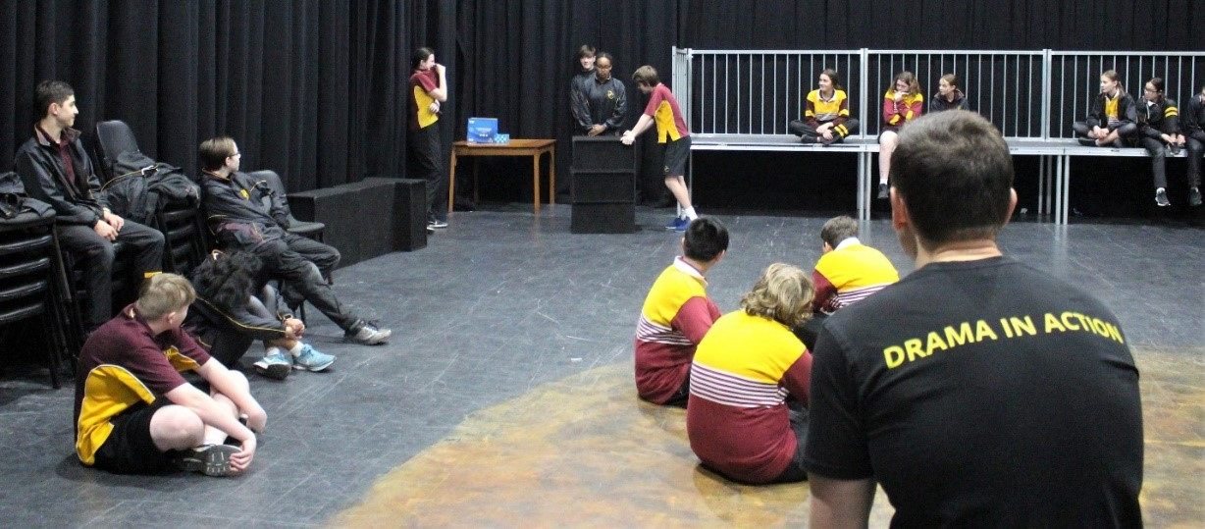
What do you do?
Assessment is practical. You will present polished performances of scripted and self-devised work backed up with written work and research in your Logbook. You will also learn about how productions are made and gain experience and knowledge in lighting, sound, poster, set and costume design.

Slide 4
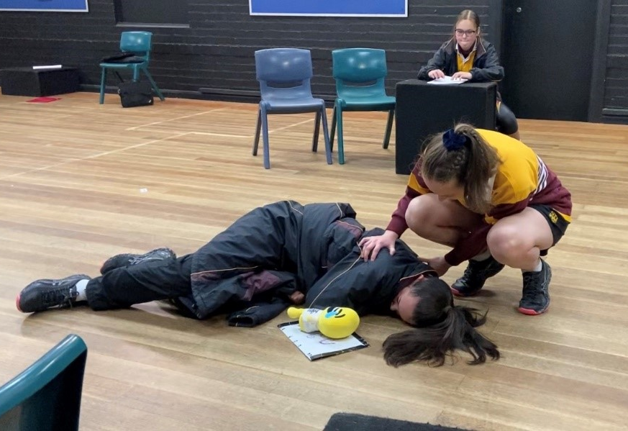
What you need?
Energy.
Enthusiasm.
A willingness to perform and learn about yourself, the world around you.
Self-reflection on your own strengths, capabilities and opportunities for growth and progress.

Slide 5
Find out more…
Please feel free to contact Mr Mike O’Brien, Head of Creative Arts, at mobrien@dominic.tas.edu.au

